Slide 1
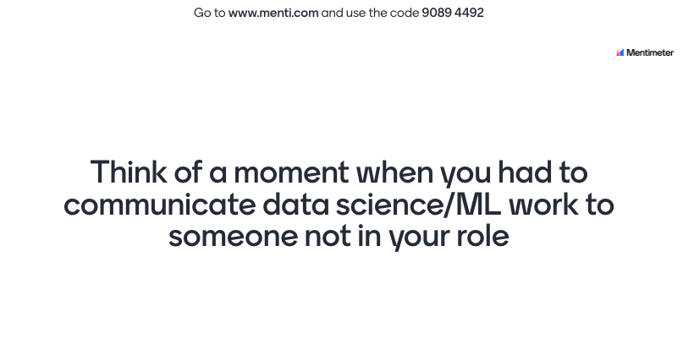
Notes:
Placeholder slide to illustrate Mentimeter

Slide 2
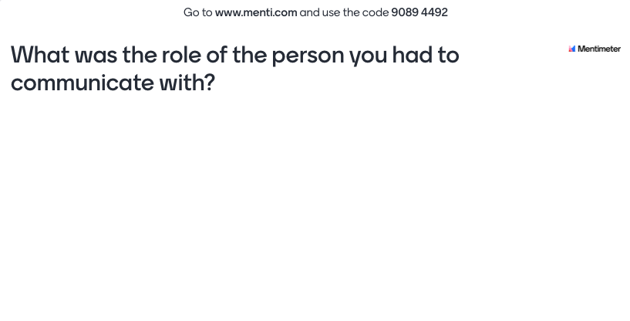
Notes:
Placeholder slide; I will update after the talk with the actual results

Slide 3
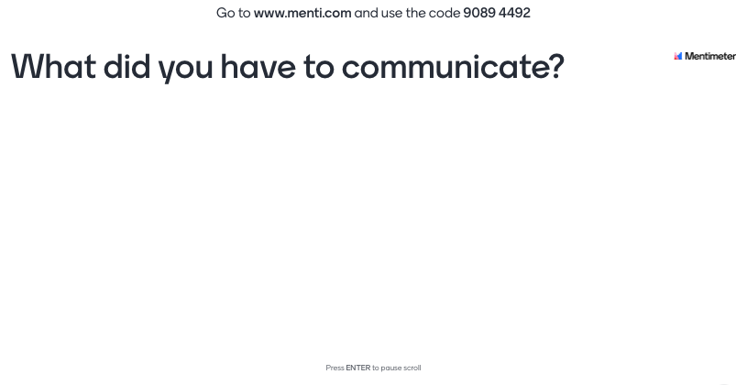
Notes:
Placeholder slide; I will update after the talk with the actual results

Slide 4

An introduction to communicating about your models
Dr Cynthia C. S. Liem MMus
Associate Professor, Multimedia Computing Group, Delft University of Technology
c.c.s.liem@tudelft.nl | @informusiccs
Notes:
Spend 5 minutes to introduce yourself and the topic. Highlight why the audience should care about the topic. If it’s something that will make their life easier, describe challenges in the current situation

Slide 5
Agenda
How I became a communicator
Communicating interdisciplinarily
Communicating for accountability
Communicating to laypeople
Conclusion
Notes:
Quick overview to help the audience brace themselves. Remember to change “Concept <x>” to a phrase that describes the concept you will explain.

Slide 6
How I became a communicator
Notes:
Spend about 10 minutes on each concept

Slide 7
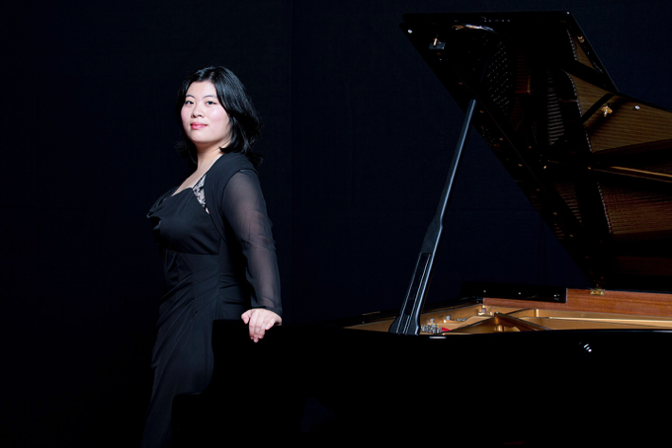
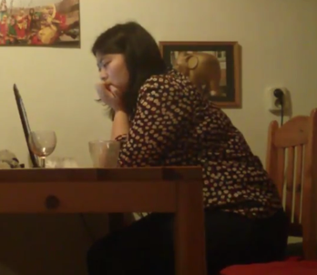
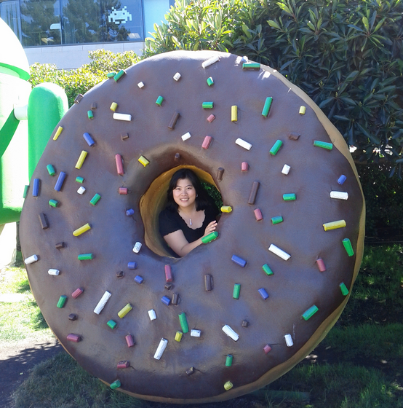
My background
© Marco Borggreve

Slide 8
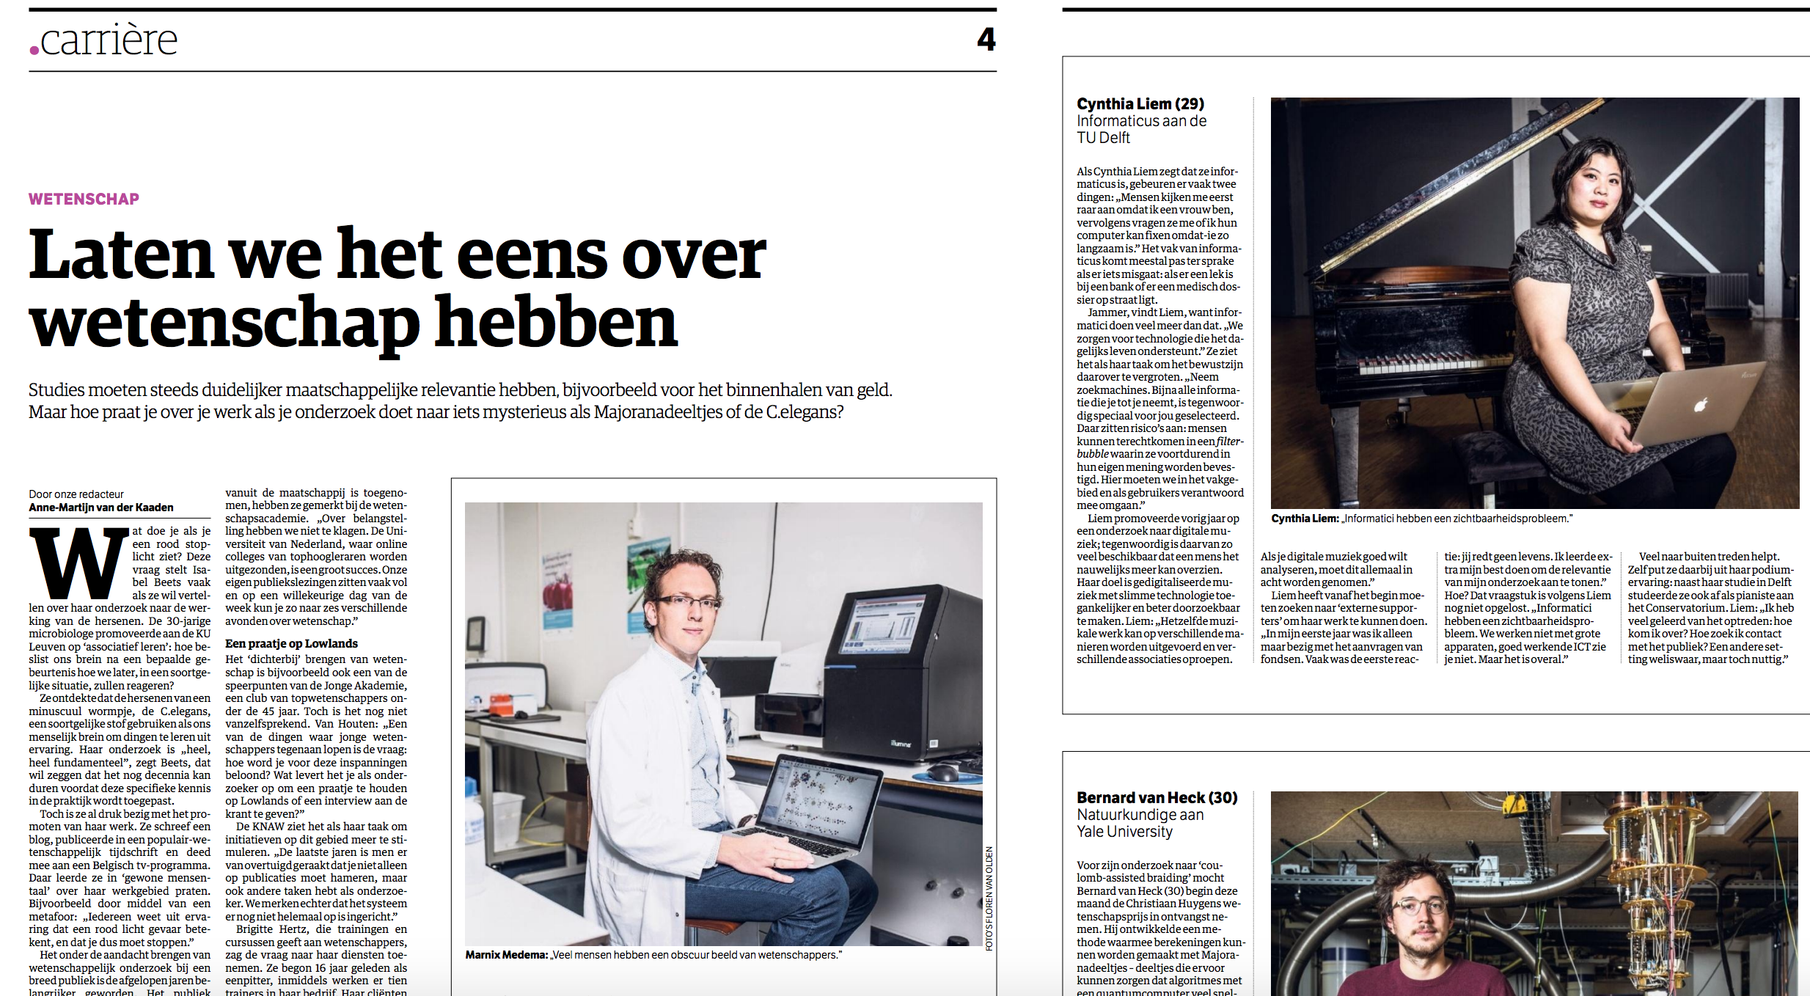
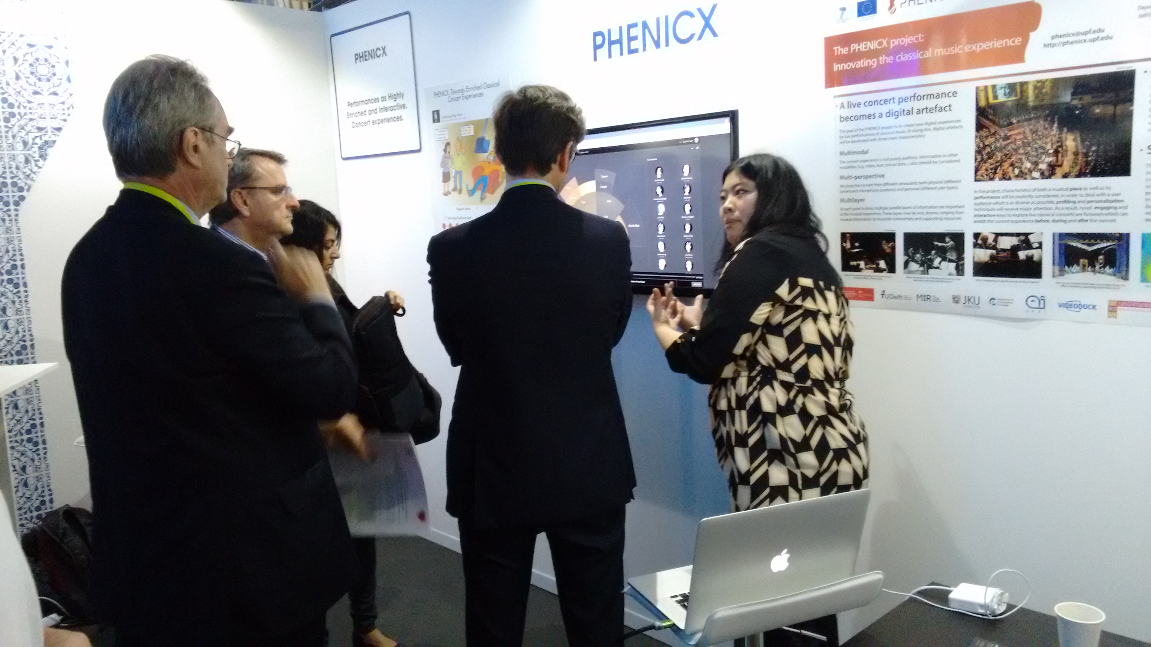
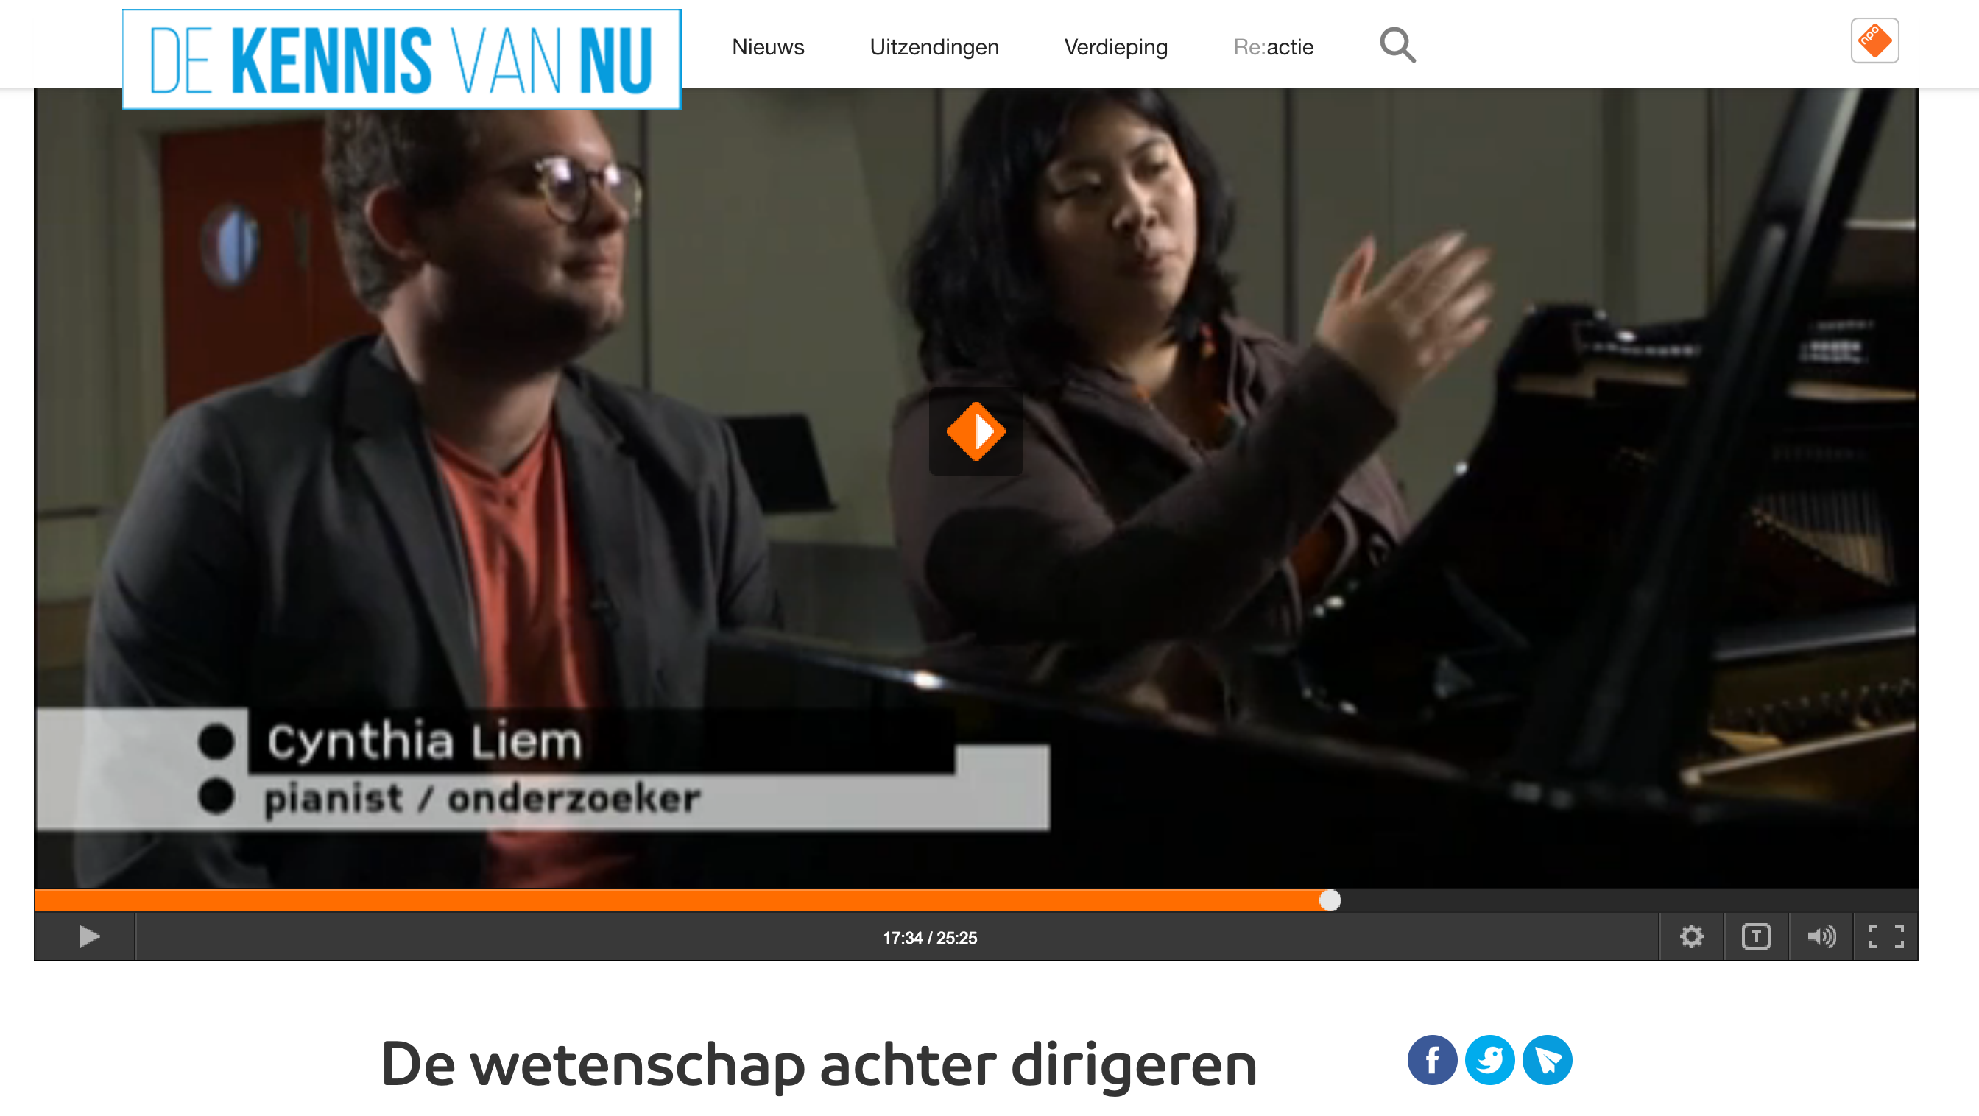
The music entrance

Slide 9
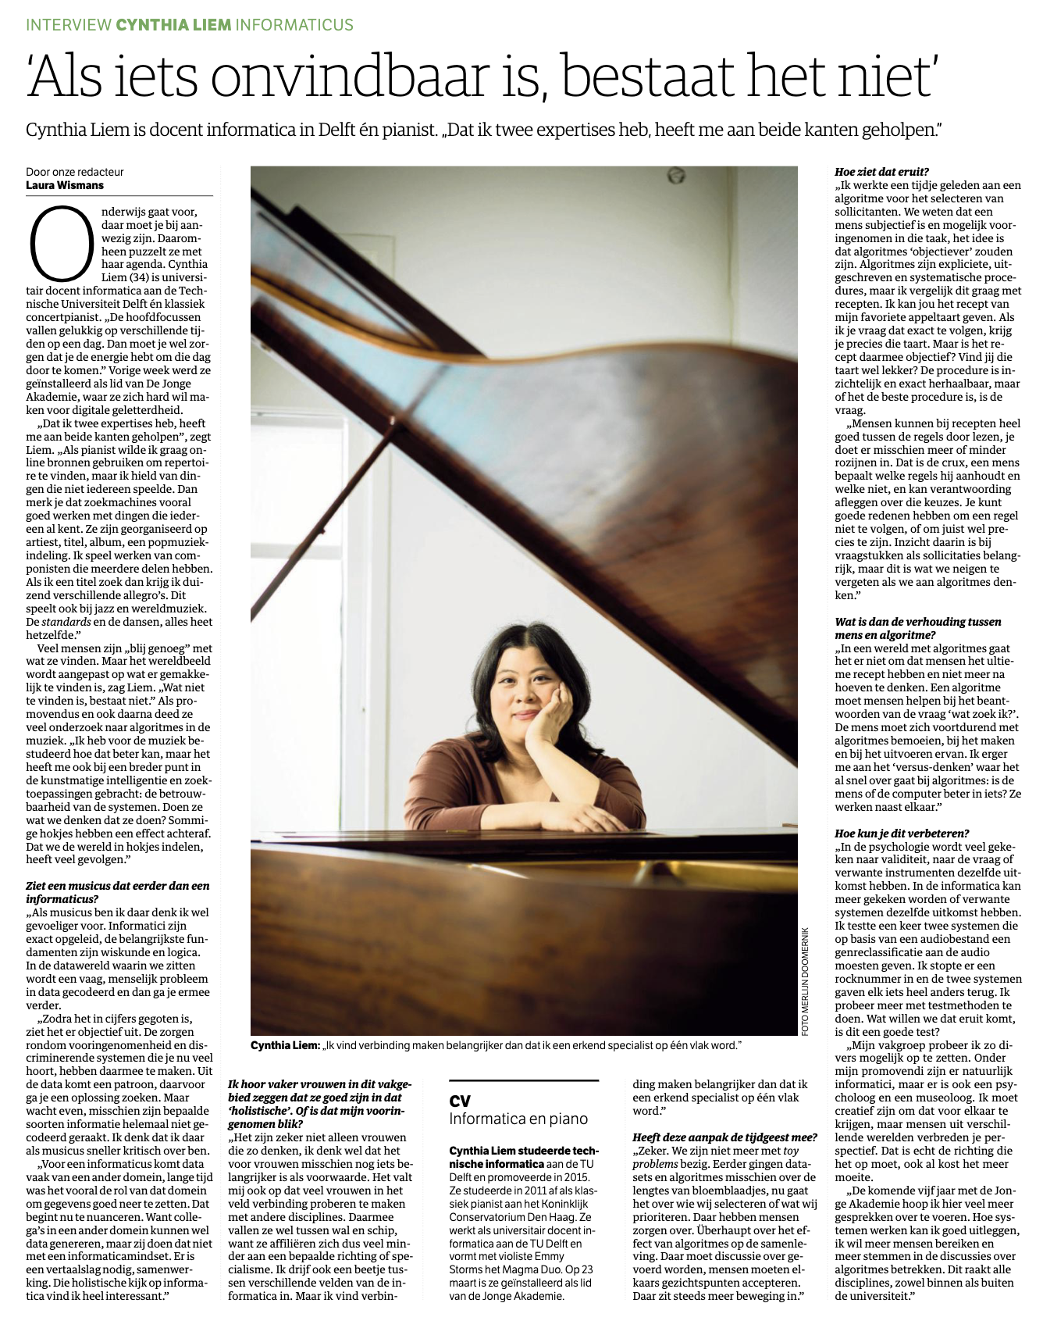
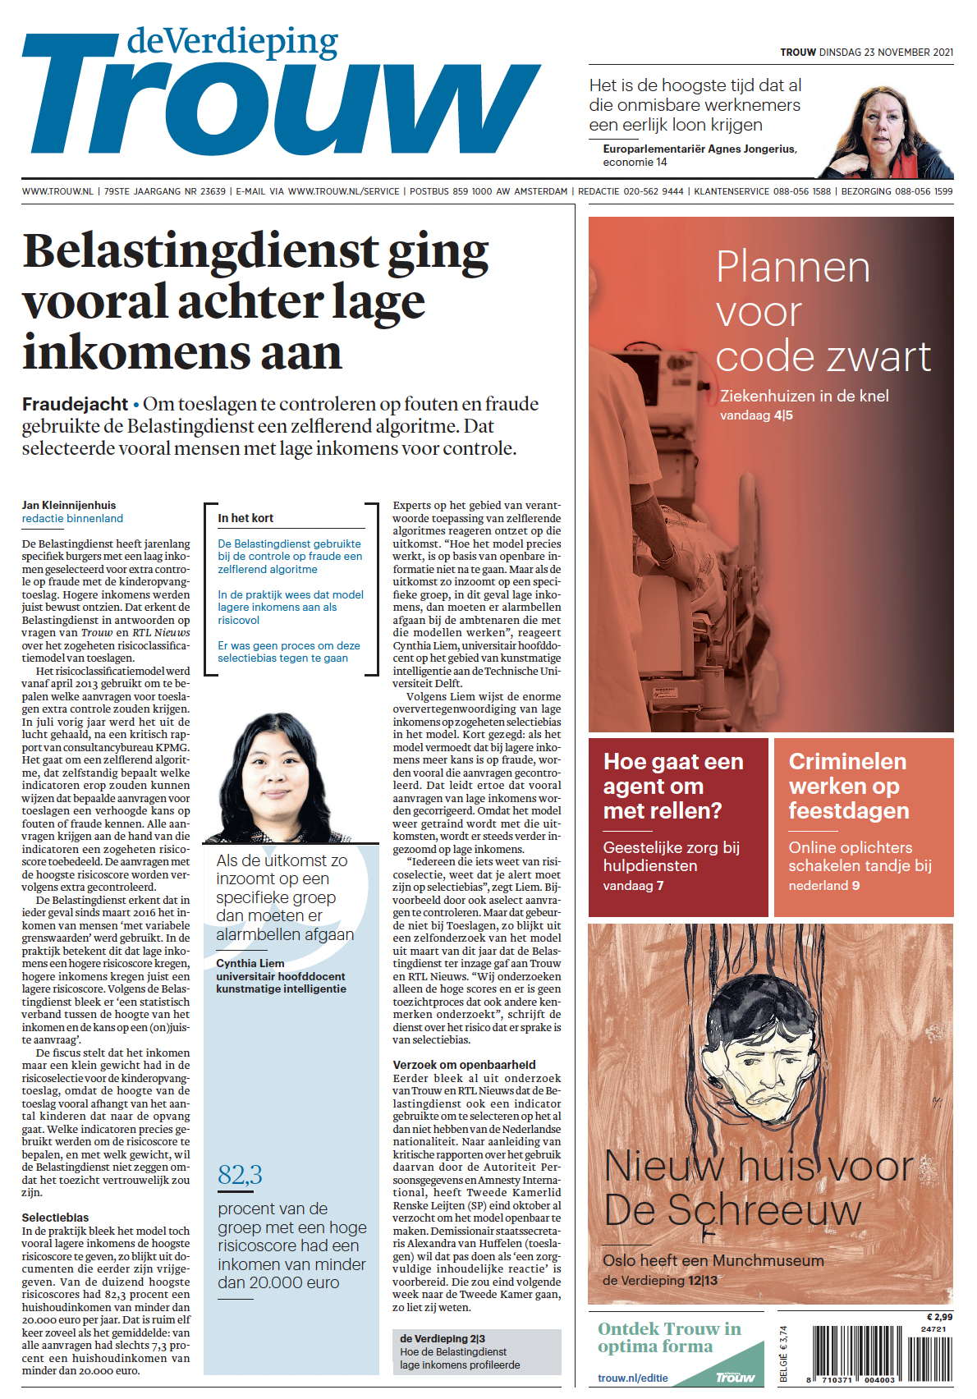
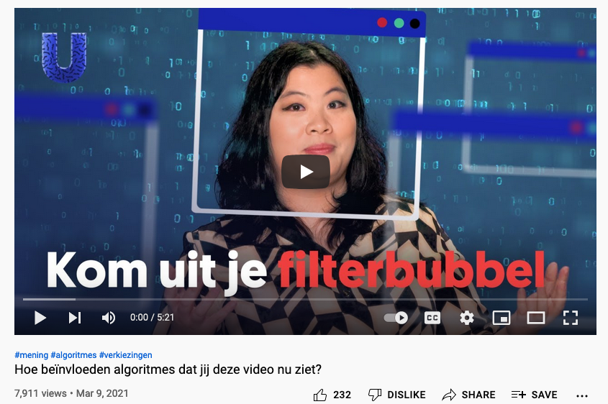
Today
https://www.trouw.nl/politiek/hoe-de-belastingdienst-lage-inkomens-profileerde-in-de-jacht-op-fraude~bbb66add/
https://www.nrc.nl/nieuws/2021/03/28/als-iets-onvindbaar-is-bestaat-het-niet-a4037549
https://www.youtube.com/watch?v=tnBcVwcoMYY

Slide 10
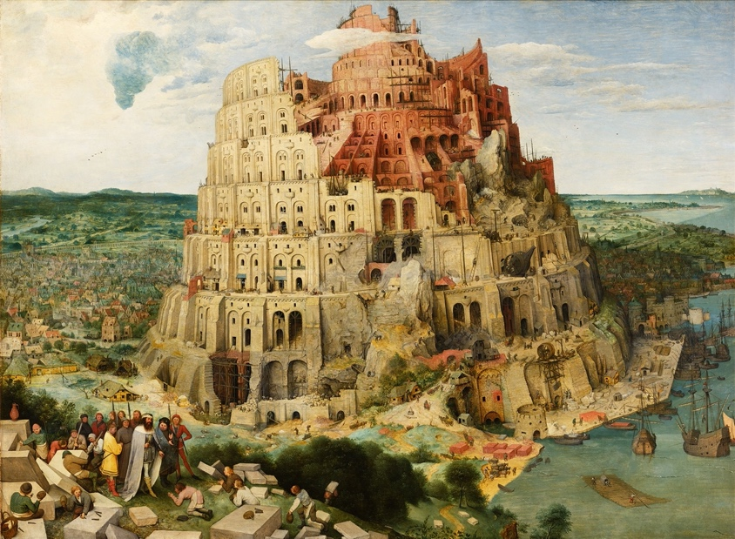
What I am encountering

Slide 11
Communicating interdisciplinarily
Notes:
Spend about 10 minutes on each concept

Slide 12
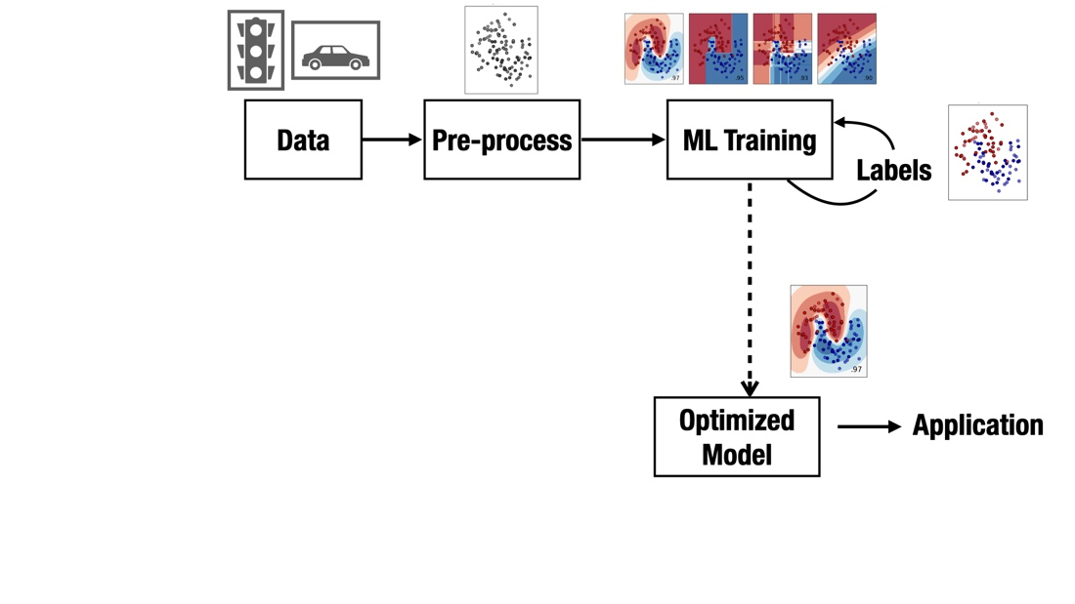
The setup

Slide 13
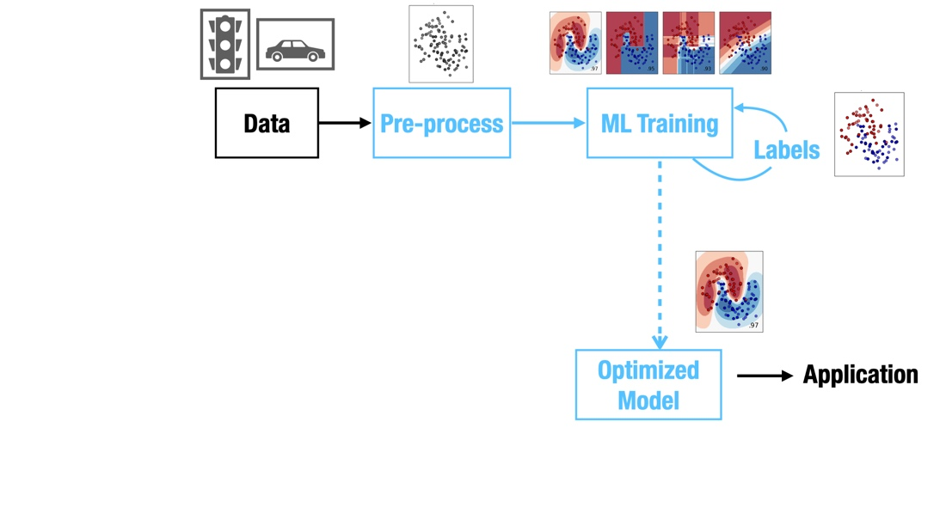
The ML expert’s focus

Slide 14
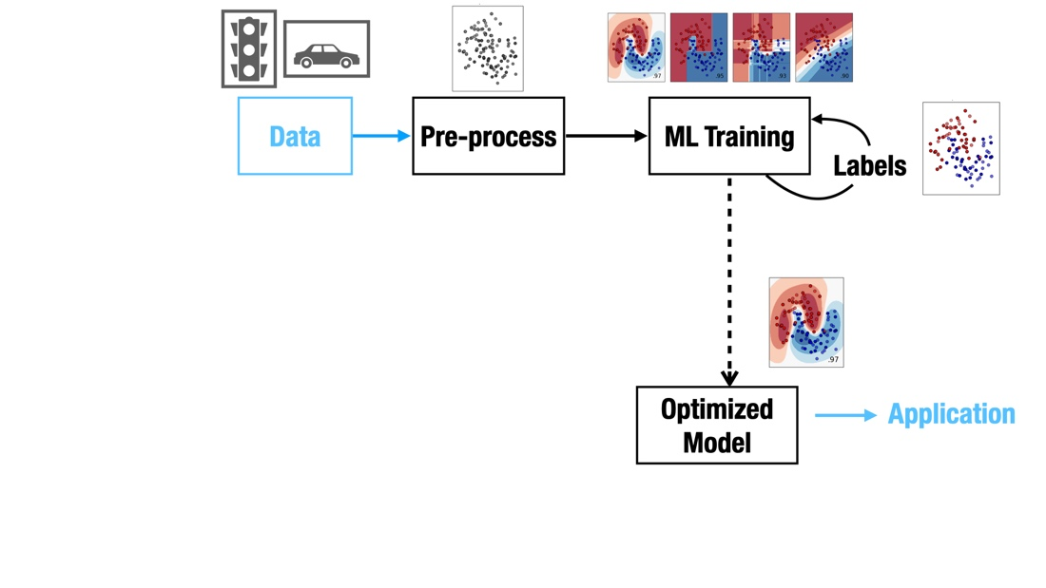
The domain expert’s focus

Slide 15
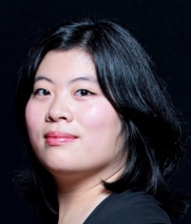
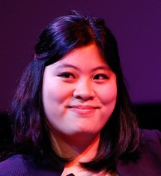
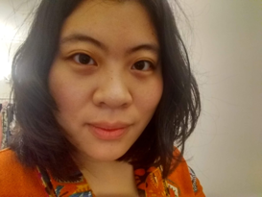
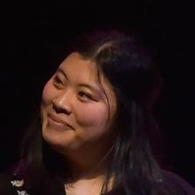
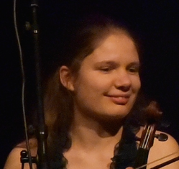

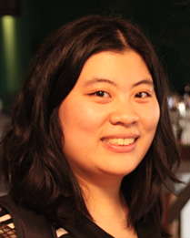
The ‘semantic gap’

Slide 16
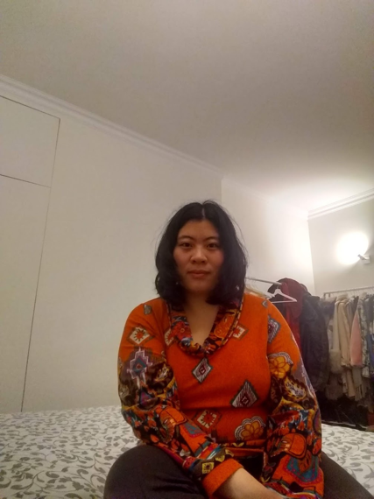


The ‘semantic gap’

Slide 17
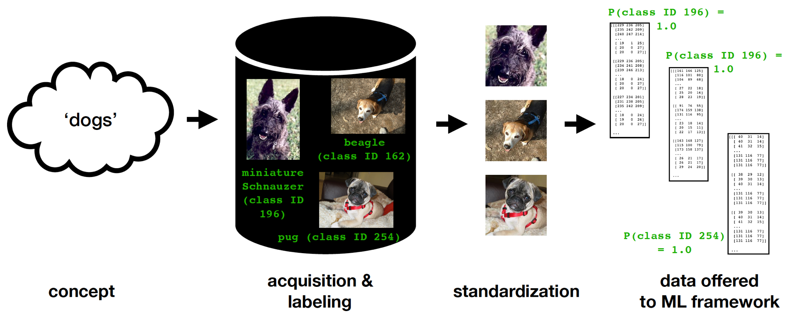
Standardization

Slide 18

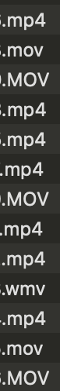
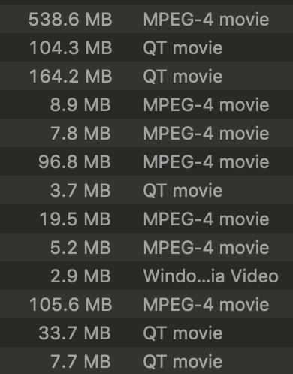
Standardization

Slide 19



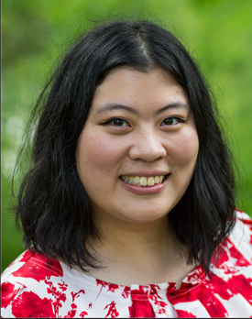
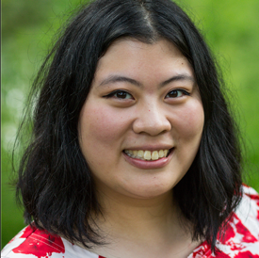

Standardization
original
cropped
scaled

Slide 20
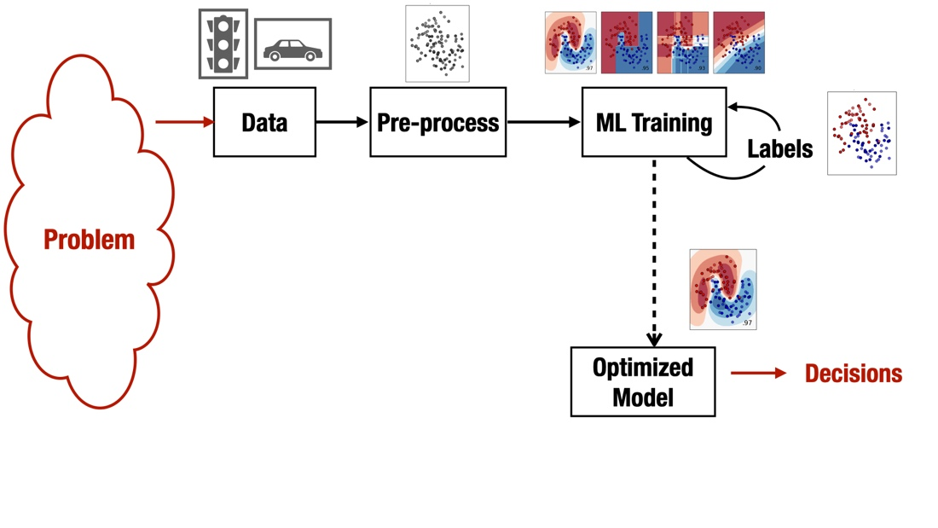
What it really may be about

Slide 21
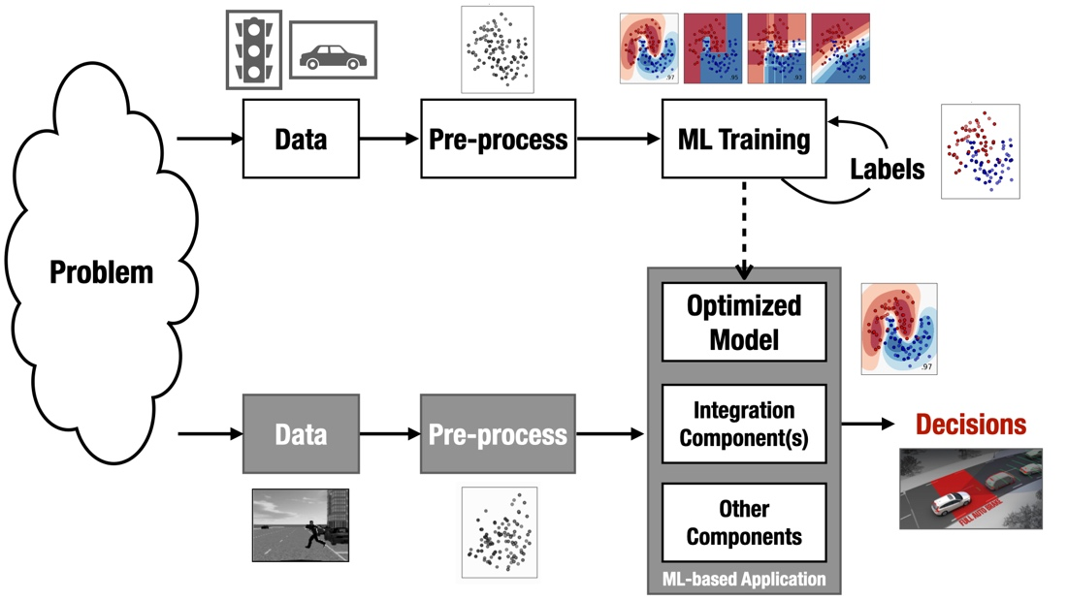
What is ‘working as intended’? What is ‘the code’?
joint work on testing for ML with Annibale Panichella

Slide 22
Communicating for accountability

Slide 23
“I want to know exactly what the algorithm is doing”

Slide 24
UWV (Employee Insurance Agency)
For the Dutch-reading audience: https://www.uwv.nl/overuwv/Images/besluit-wob-verzoek-inzake-software-en-algoritmes.pdf
Source code of used software and algorithms
‘We use Python 3.7.5’
‘We also use SQL server 2016. It is licensed by Microsoft, we cannot share source code’
‘Python is open source so we won’t share code either’
‘Model can be found at https://github.com/scikit-learn/scikit-learn/blob/main/sklearn/ensemble/hist_gradient_boosting/gradient_boosting.py ’

Slide 25
UWV (Employee Insurance Agency)
For the Dutch-reading audience: https://www.uwv.nl/overuwv/Images/besluit-wob-verzoek-inzake-software-en-algoritmes.pdf
Source code of used software and algorithms
‘We use Python 3.7.5’
‘We also use SQL server 2016. It is licensed by Microsoft, we cannot share source code’
‘Python is open source so we won’t share code either’
‘Model can be found at https://github.com/scikit-learn/scikit-learn/blob/main/sklearn/ensemble/hist_gradient_boosting/gradient_boosting.py ’

Slide 26
UWV (Employee Insurance Agency)
For the Dutch-reading audience: https://www.uwv.nl/overuwv/Images/besluit-wob-verzoek-inzake-software-en-algoritmes.pdf
Source code of used software and algorithms
‘We use Python 3.7.5’
‘We also use SQL server 2016. It is licensed by Microsoft, we cannot share source code’
‘Python is open source so we won’t share code either’
‘Model can be found at https://github.com/scikit-learn/scikit-learn/blob/main/sklearn/ensemble/hist_gradient_boosting/gradient_boosting.py ’

Slide 27
UWV (Employee Insurance Agency)
For the Dutch-reading audience: https://www.uwv.nl/overuwv/Images/besluit-wob-verzoek-inzake-software-en-algoritmes.pdf
Source code of used software and algorithms
‘We use Python 3.7.5’
‘We also use SQL server 2016. It is licensed by Microsoft, we cannot share source code’
‘Python is open source so we won’t share code either’
‘Model can be found at https://github.com/scikit-learn/scikit-learn/blob/main/sklearn/ensemble/hist_gradient_boosting/gradient_boosting.py ’

Slide 28
UWV (Employee Insurance Agency)
For the Dutch-reading audience: https://www.uwv.nl/overuwv/Images/besluit-wob-verzoek-inzake-software-en-algoritmes.pdf
Source code of used software and algorithms
‘We use Python 3.7.5’
‘We also use SQL server 2016. It is licensed by Microsoft, we cannot share source code’
‘Python is open source so we won’t share code either’
‘Model can be found at https://github.com/scikit-learn/scikit-learn/blob/main/sklearn/ensemble/hist_gradient_boosting/gradient_boosting.py ’

Slide 29
UWV (Employee Insurance Agency)
For the Dutch-reading audience: https://www.uwv.nl/overuwv/Images/besluit-wob-verzoek-inzake-software-en-algoritmes.pdf
Source code of used software and algorithms
‘We have algorithm documentation, scripts and a Data Protection Impact Assessment. These will not be shared because of their strategic importance to our servicing.’

Slide 30
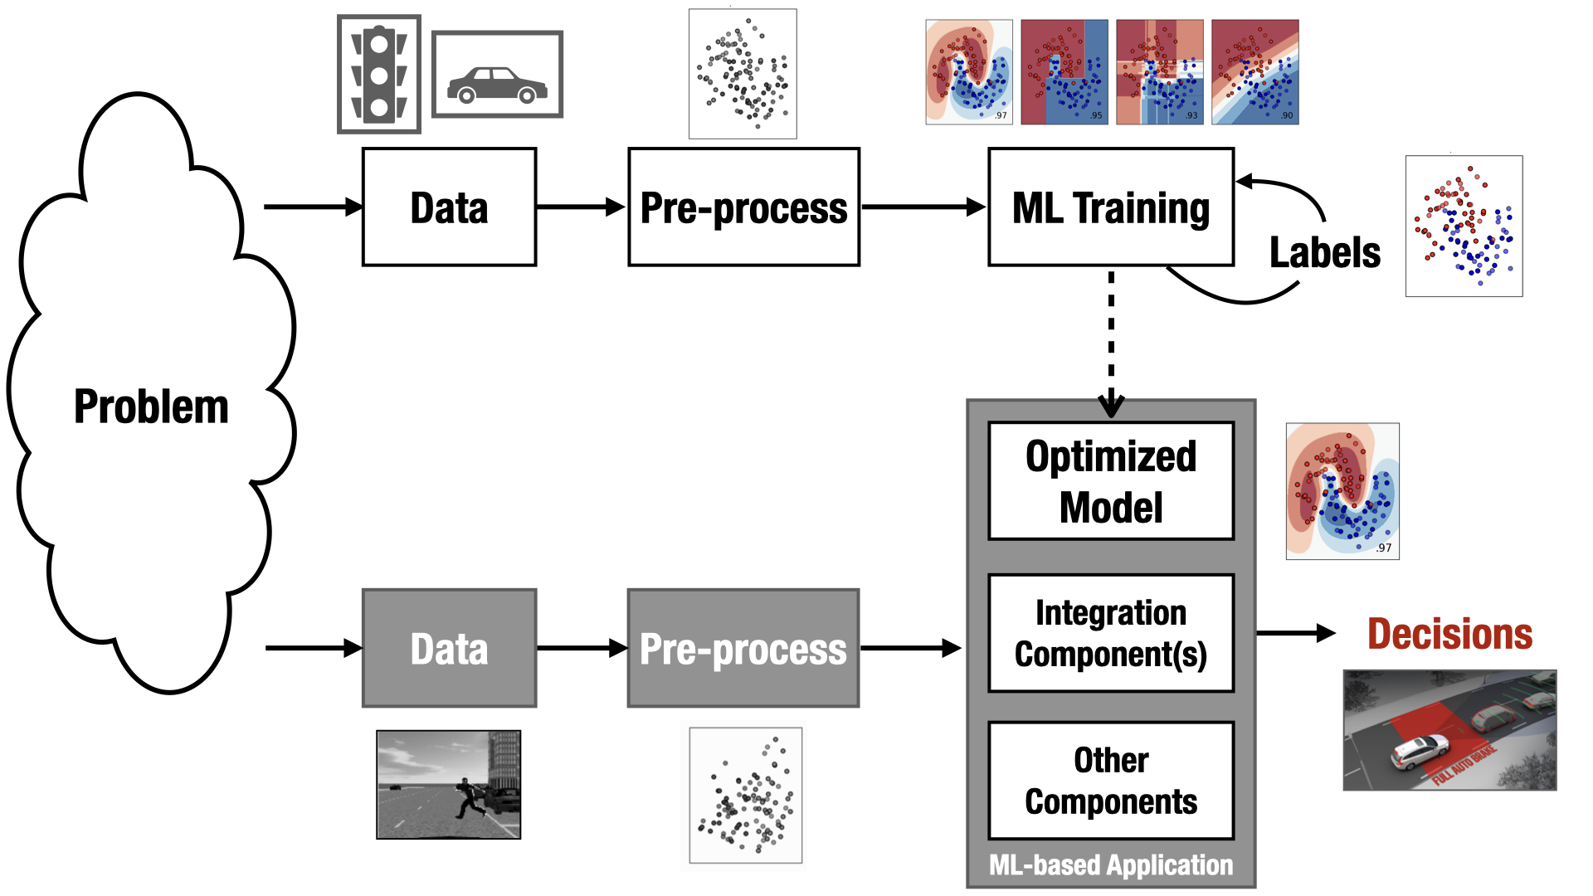
‘Can you walk me through the code?’

Slide 31
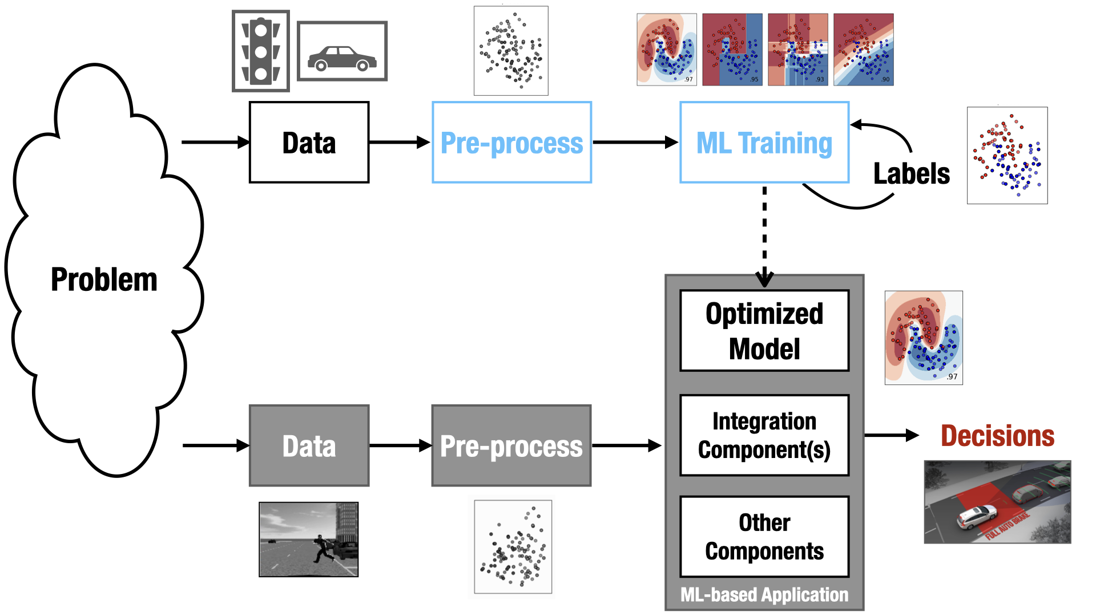
‘Can you walk me through the code?’

Slide 32
‘Should this sensitive attribute have been included?’

Slide 33
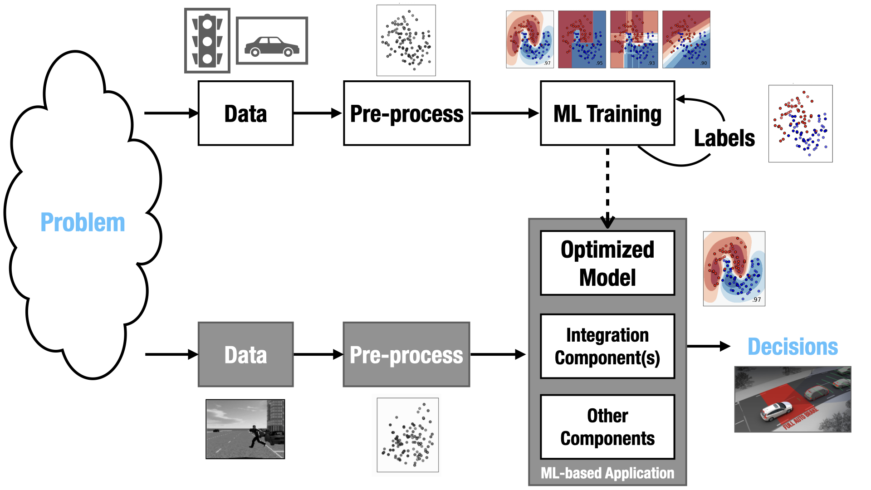
‘Should this sensitive attribute have been included?’

Slide 34
Communicating to laypeople
Notes:
Spend about 10 minutes on each concept

Slide 35
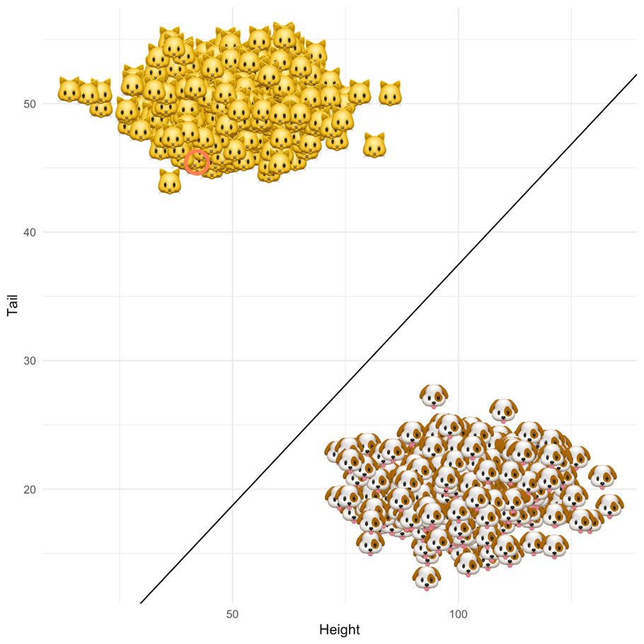
Learning patterns from data
illustration by Patrick Altmeyer

Slide 36
Learning patterns from data
illustration by Patrick Altmeyer
dog or cat?

Slide 37
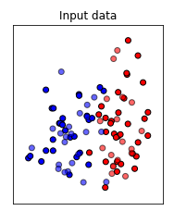
Learning patterns from data

Slide 38
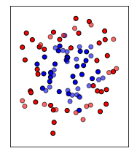
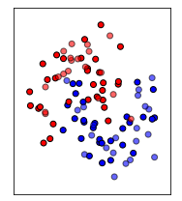
Learning patterns from data

Slide 39
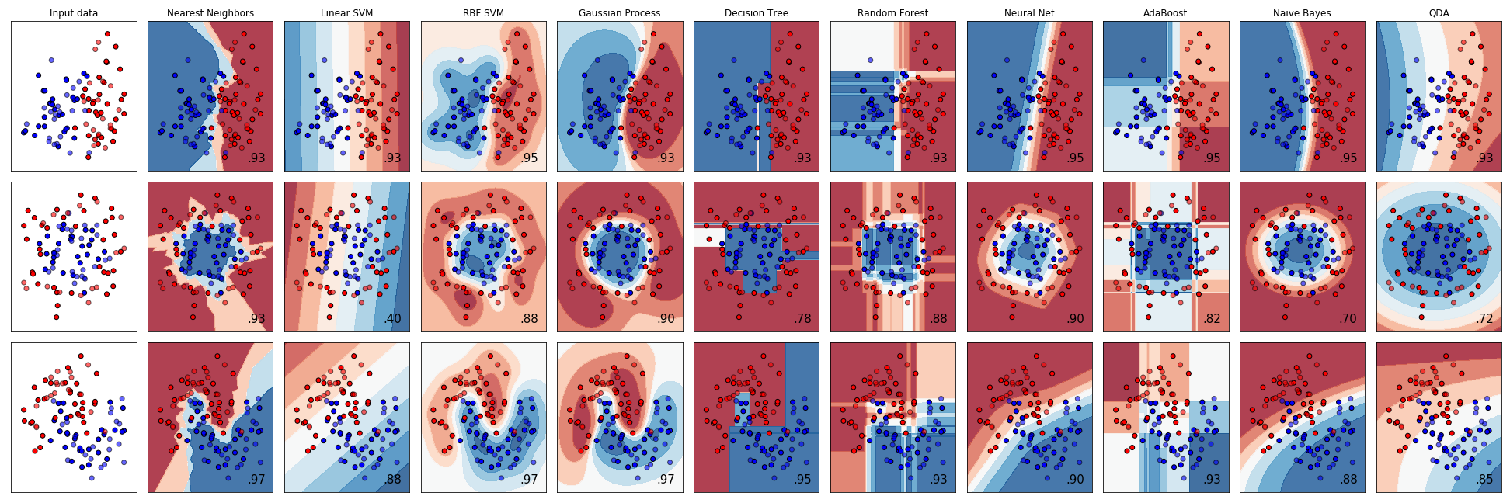
Learning patterns from data

Slide 40
Learning patterns from data

Slide 41
Learning patterns from data

Slide 42
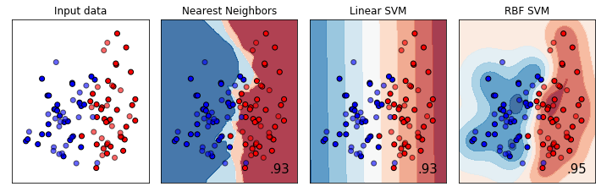
Learning patterns from data

Slide 43
From data to decision-making
*
*
*
*
x
*
*
x
*
*
*
x
*
x
x
x
x
x
x
x

Slide 44
From data to decision-making
.
.
*
*
*
.
*
x
.
*
*
.
x
.
*
*
*
.
.
.
x
*
.
x
.
.
.
x
x
x
.
x
.
x
x

Slide 45
What if you only can pick 5 points?
.
.
*
*
*
.
*
x
.
*
*
.
x
.
*
*
*
.
.
.
x
*
.
x
.
.
.
x
x
x
.
x
.
x
x

Slide 46

What if you only can pick 5 points?
https://tudelft.fra1.qualtrics.com/jfe/form/SV_3I8HIOZxBVamFIW

Slide 47
Conclusion
We need to grow literacy.
Especially at the interfaces between data-driven pipelines and their surrounding contexts.
This goes beyond introductory ML and programming courses.
Notes:
Steer the focus of your audience using transparent blocks to . You create them by creating any shape. Make sure to set the border to transparent. Chose the fill color: Click on the same color as the background (in this case white) and click on the +sign under custom colors. This allows you to change the transparency. You can play around with the settings, but somewhere around 75% transparency should work.

Slide 48

Conclusion

Slide 49

if questions:
try:
answer()
except RuntimeError:
pass
else:
print("Thank You.")
Notes:
Nervous for questions? Prepare a question and share it with the host. The host can ask you this question at the end of the presentation. This helps the host and breaks the ice for you to start answering questions more confidently.

Slide 50
References
C.C.S. Liem et al., Psychology meets Machine Learning: Interdisciplinary perspectives on algorithmic job candidate screening, in Explainable and Interpretable Models in Computer Vision and Machine Learning (pp. 197-253), 2018.
C.J. König et al., Some Advice for Psychologists Who Want to Work With Computer Scientists on Big Data, Personnel Assessment and Decisions, vol. 6 no. 1, 2020.
A. Panichella & C.C.S. Liem, What Are We Really Testing in Mutation Testing for Machine Learning? A Critical Reflection, 43rd Conference on International Conference on Software Engineering (ICSE) – New Ideas and Emerging Results, 2021.
Notes:
Add references as a slide so that you can share this with the audience. You don’t have to show this during the presentation.

